Slide 1



Learn Japanese at
Your School
Your Department
Teacher Profile: YOUR NAME
www.jflalc.org/brochure.html
YOUR
PHOTO
HERE
This brochure is free and customizable.
Available for download at:
Other Details
……
Program highlights
Classes available
Annual events
AP Exam pass rate
WHATEVER YOU LIKE!

Slide 3

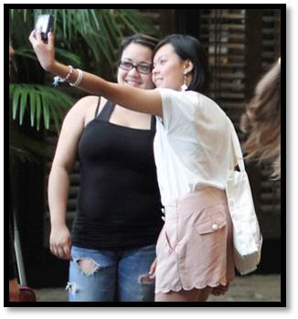




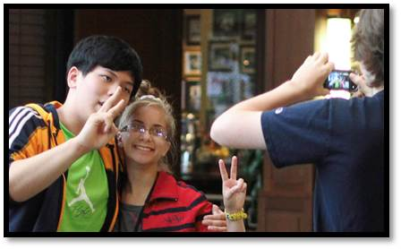


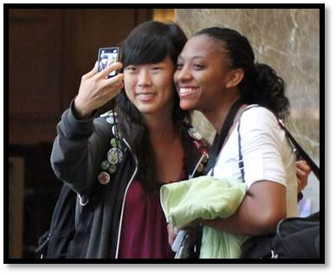

Slide 4







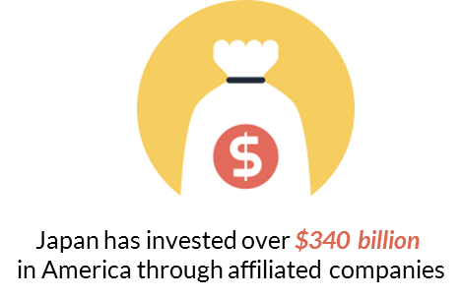

Slide 5





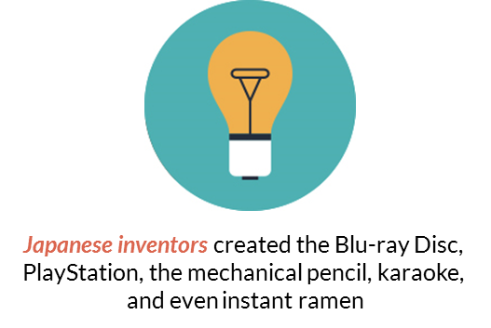
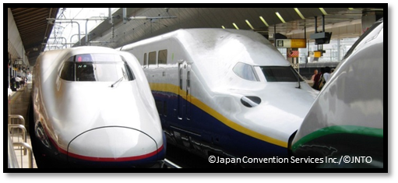



Slide 6











Slide 7




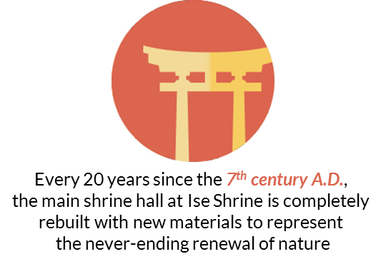




Slide 8





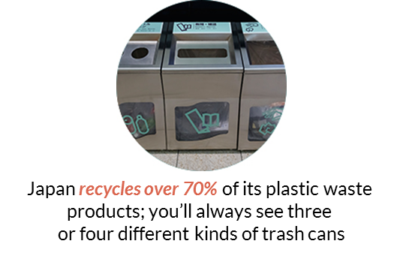


Slide 9








Slide 10


