Slide 1
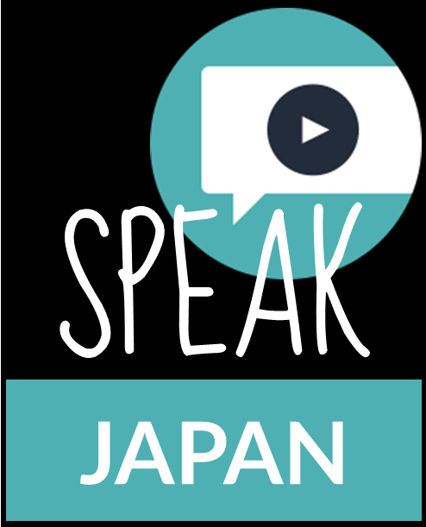
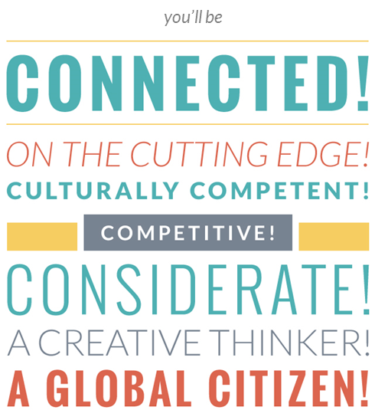
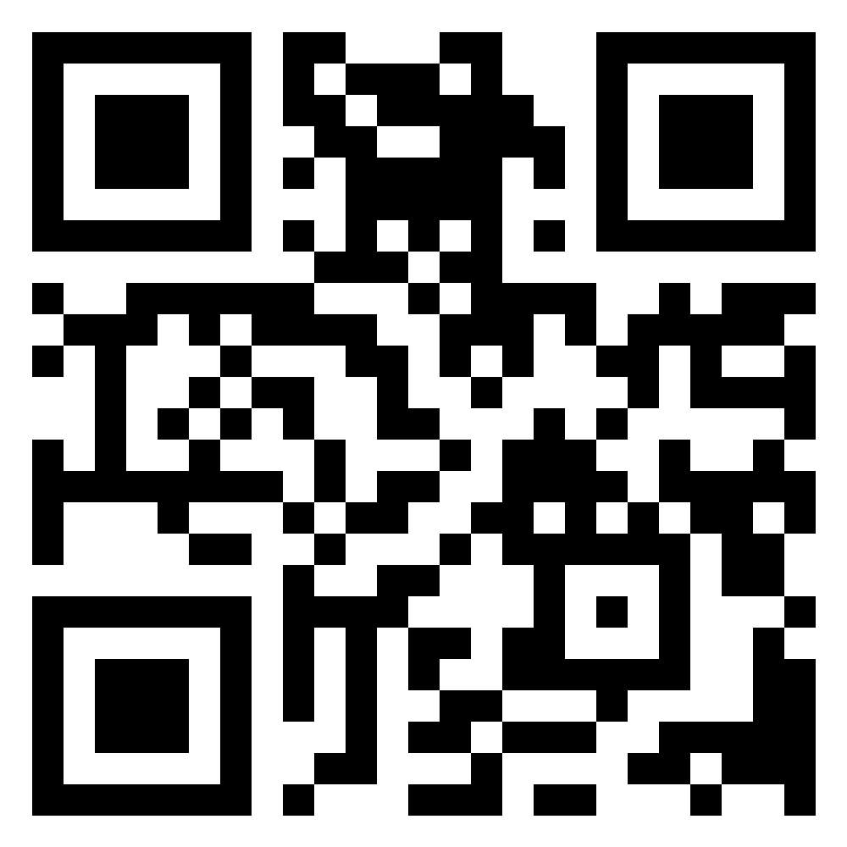

Your School
Your Department
Teacher Profile: YOUR NAME
www.jflalc.org/brochure.html
YOUR
PHOTO
HERE
This brochure is free and customizable.
Available for download at:
Other Details
……
Program highlights
Classes available
Annual events
AP Exam pass rate
WHATEVER YOU LIKE!

Slide 3
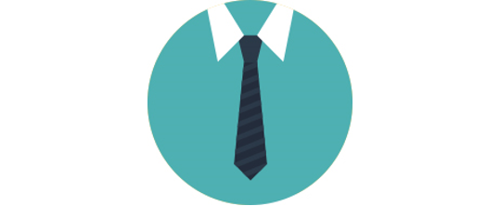
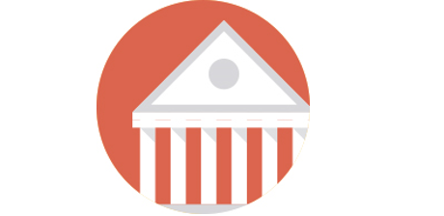
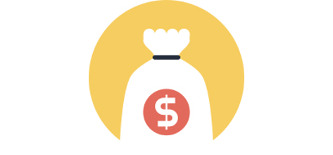

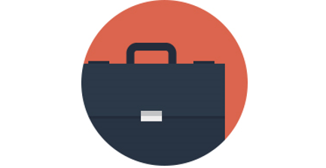
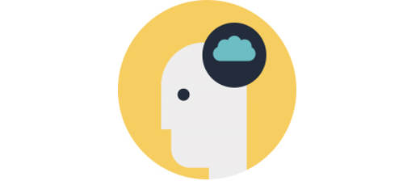
CAREER
Learning Japanese gives you more
options in the job market
Japanese companies are responsible for creating nearly 1 million American jobs (2024)
Japanese is designated by the U.S. Department of State as one of
15 Critical Languages essential to the United States’ security and prosperity
Japan is the top provider of foreign direct investment in the United States (2023)
Japanese is America’s 4th largest trading partner, with bilateral trade over $200 billion (2024)
Japan is the world’s 3rd largest economy, with GDP of $4.2 Trillion (2023)
Language learners are comfortable with other cultures – a sought-after 21st century skill in today’s global market

Slide 4
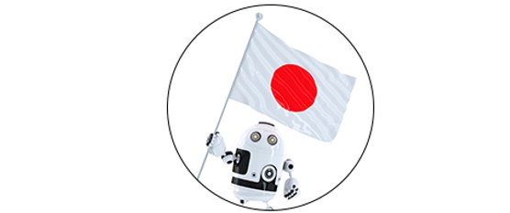
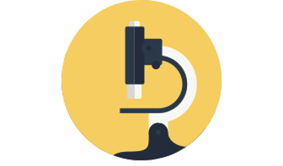
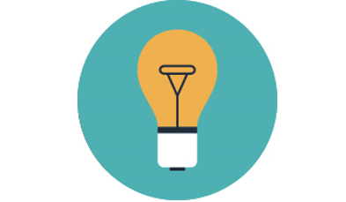

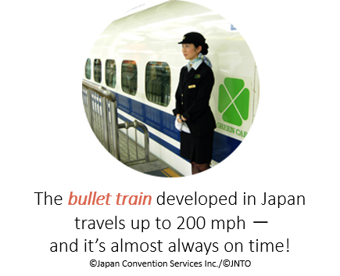
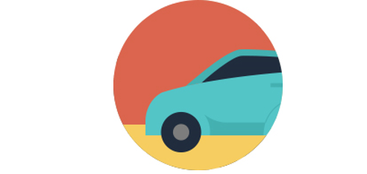

INNOVATION
Learning Japanese gets you direct
access to cutting-edge technology
Japan is the world’s number one industrial robot manufacturer – delivering 45% of the global supply (2022)
Japan has produced 20 Nobel science laureates, ranking 5th place in the world (2024)
Japanese inventors created emojis, Nintendo, PlayStation, karaoke, and even instant ramen
​The U.S. and Japan have reinforced their partnership in space exploration through agreements facilitating collaboration on lunar missions (2024)
The bullet train developed in Japan travels up to 200 mph – and it’s almost always on time!
Toyota, Honda, Nissan and other well-known Japanese car companies have more than a third of America’s automobile market share (2024)
Japanese companies commit to innovation, their annual R&D expenditures in the U.S. reached a record $12 billion (2021)

Slide 5
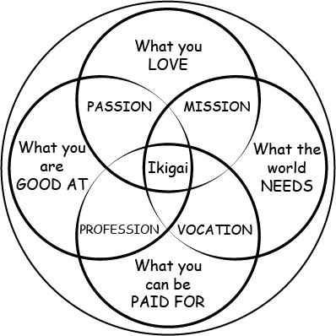

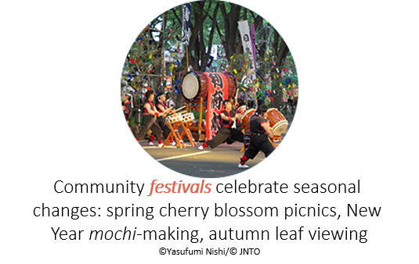
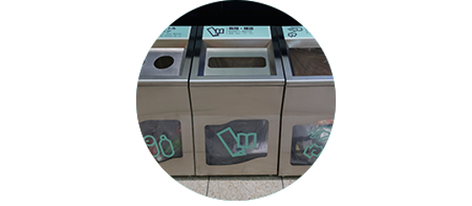
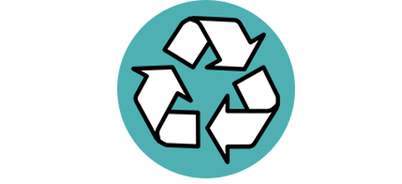
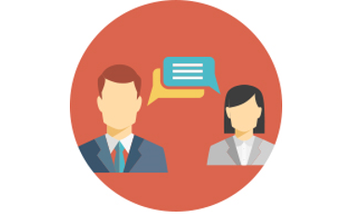
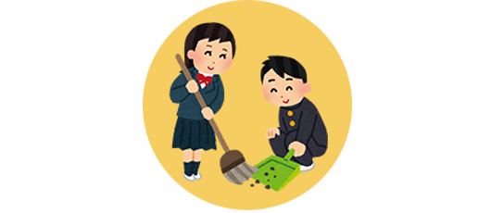
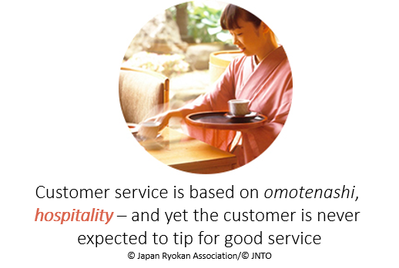
LIFESTYLE
Learning Japanese exposes you to fun
and thoughtful ways to live life
The philosophical concept of “ikigai” helps us understand what to do in life, it has been widely introduced through the book Ikigai: The Japanese Secret to a Long and Happy Life
Japan's public transportation system is known for its extensive coverage, facilitating convenient and affordable travel across the country throughout urban and rural areas
Community festivals celebrate seasonal changes such as spring cherry blossom picnics and fall leaf viewing
Japan recycles over 80% of its paper and plastic waste; you’ll always see three or four different kinds of trash cans there
Nobel laureate Wangari Maathai used the phrase “Mottai nai” (Such a waste!) as a slogan for environmental conservation
Learning Japanese aids social awareness: the language’s politeness levels change depending on the social situation
Japanese children are taught responsibility for their space – students routinely clean up their school
Customer service is based on omotenashi, hospitality – and yet the customer is never expected to tip for good service

Slide 6
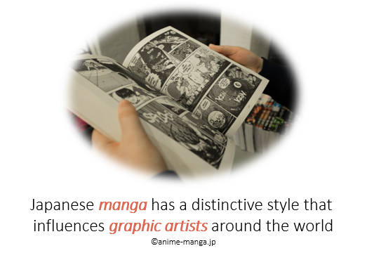

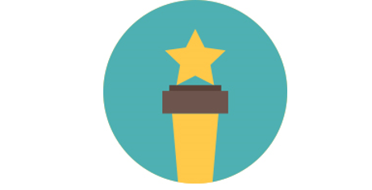
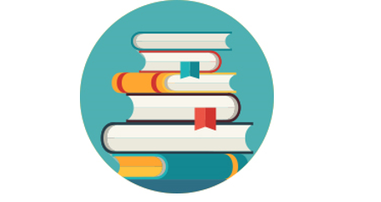
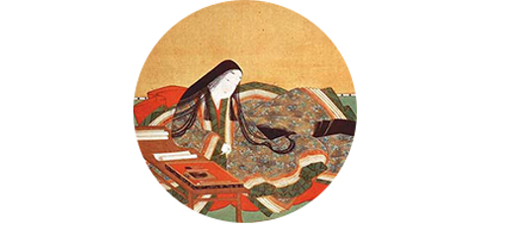
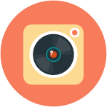
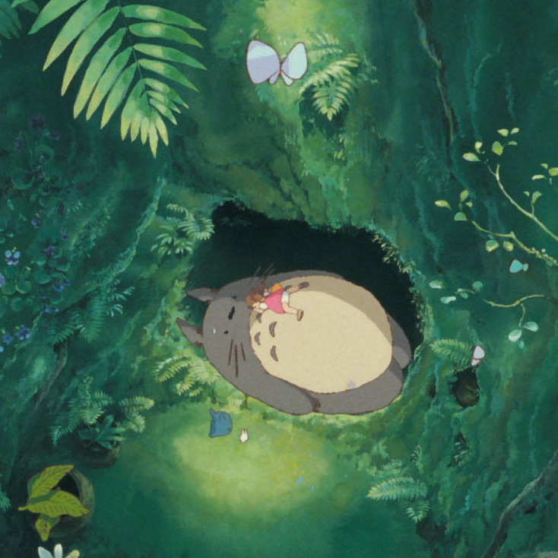
IMAGINE
Learning Japanese immerses you
in fantasy
Japanese Manga and Anime are popular around the world, and are fun mediums to study the language
​Pokémon is the highest-grossing media franchise in the world (Followed by Hello Kitty – also Japanese!)
​The 2024 series "Shōgun" won 18 Emmy Awards setting a record for the most wins by a single season in Emmy history.
The works of contemporary magical realism novelist Haruki Murakami have been translated into 50 languages
Noblewoman Murasaki Shikibu wrote The Tale of Genji in the 11th century, arguably the oldest novel ever written
Akira Kurosawa's films have left an indelible mark on international cinema, inspiring numerous filmmakers worldwide
​Studio Ghibli's films have profoundly influenced global animation with their unique blend of reality and fantasy

Slide 7

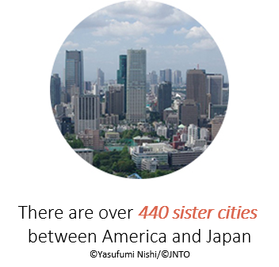
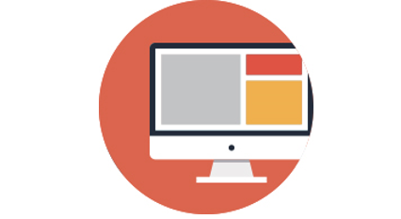
CONNECT
Learning Japanese connects you
globally
More than 66,000 Americans are living and working in Japan, and more than
3 million Americans visited Japan (2024)
There are over 450 sister cities between America and Japan (2021)
Japanese is the 4th most frequently used language for web content (2025)

Slide 8
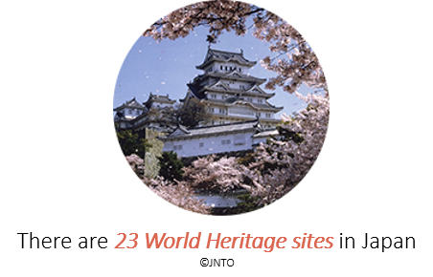
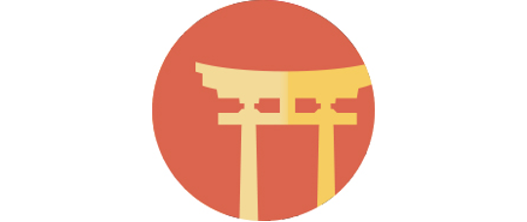
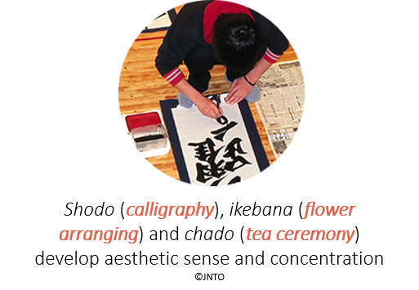
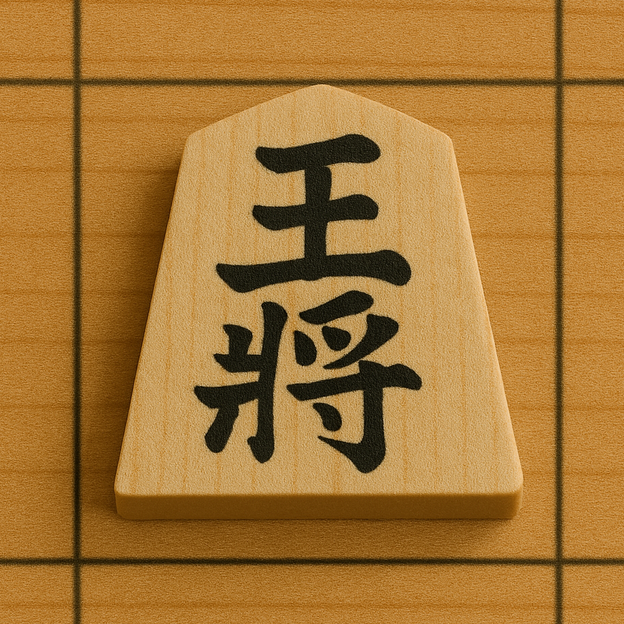
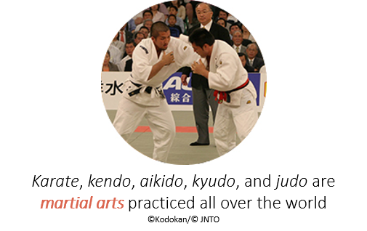
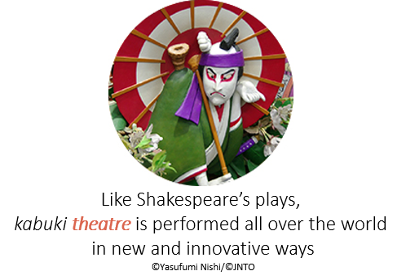
TRADITION
Learning Japanese exposes you to a
beautiful heritage which contemporary
people practice creatively
There are 23 World Heritage sites in Japan
(2024)
There are more Shinto shrines than convenient stores in Japan – people regularly visit them for cultural and religious reasons
Shodo (calligraphy), ikebana (flower arranging) and chado (tea ceremony) develop aesthetic sense and concentration
Shogi, or Japanese chess, is a strategy board game dating back to the 9th century that is renowned for its depth and complexity
Karate, kendo, aikido, kyudo, and judo are martial arts practiced all over the world
Like Shakespeare’s plays, kabuki theatre is performed all over the world in new and innovative ways

Slide 9
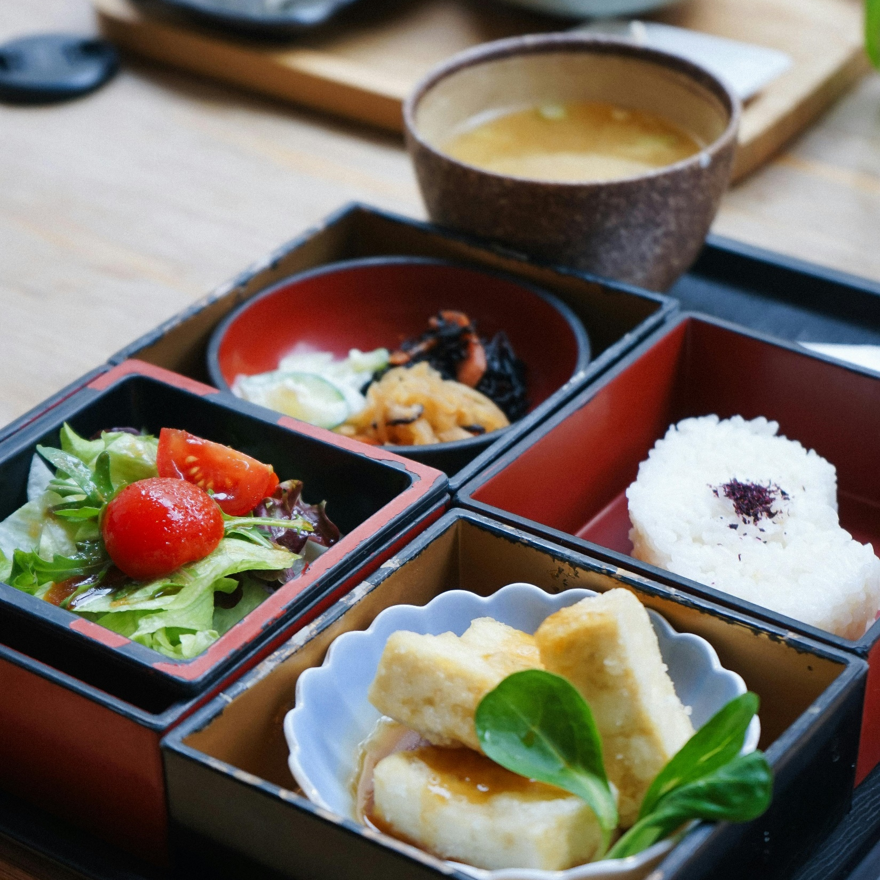
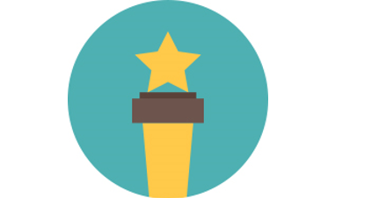

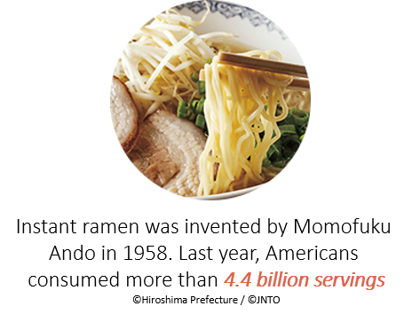
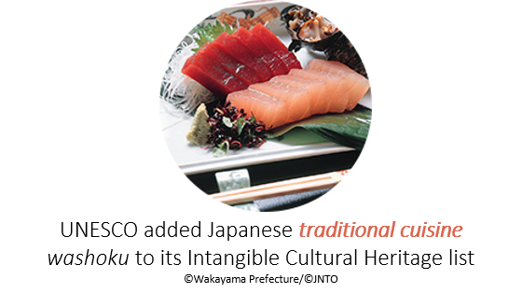
TASTE
Learning Japanese is delicious (oishii!)
There are more than 26,000 Japanese restaurants in the US (2023)
More Michelin stars are awarded to restaurants in Tokyo than to restaurants in Paris (2024)
In addition to sweet, sour, salty, and bitter, there is a fifth basic taste: umami (“savory”), named by a Japanese chemist
Instant ramen was invented by Momofuku Ando in 1958. Americans consumed approximately 5.1 billion servings (2023)
UNESCO recognizes Japanese traditional cuisine, Washoku (2013) and Japanese sake making to its Intangible Cultural Heritage list (2024)

