Slide 1
Your School
Your Department
Teacher Profile: YOUR NAME
www.jflalc.org/brochure.html
YOUR
PHOTO
HERE
This brochure is free and customizable.
Available for download at:
Other Details
……
Program highlights
Classes available
Annual events
AP Exam pass rate
WHATEVER YOU LIKE!

Slide 3
CAREER
Learning Japanese gives you more
options in the job market

Slide 4
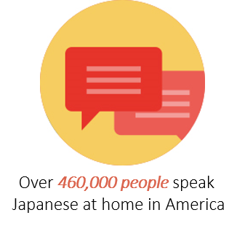
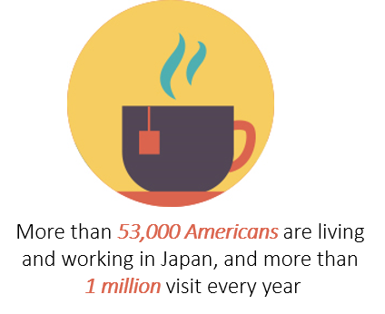
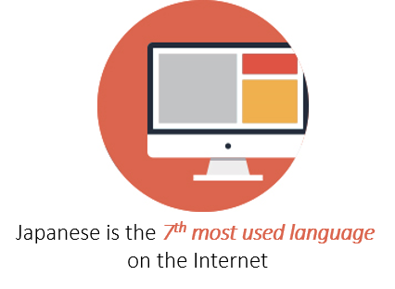
CONNECT
Learning Japanese connects you
globally

Slide 5
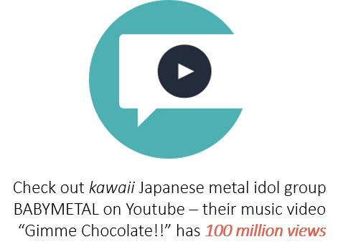
DESIGN
Learning Japanese inspires creativity

Slide 6
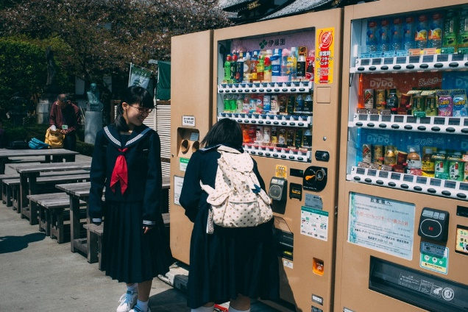
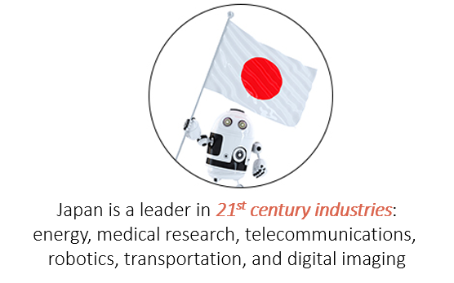
INNOVATION
Learning Japanese gets you direct
access to cutting-edge technology

Slide 7
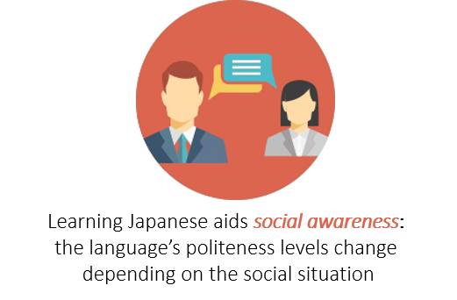
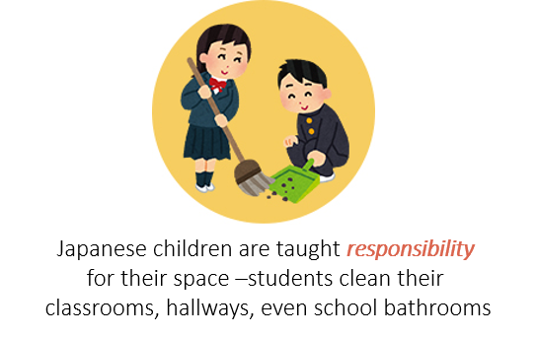
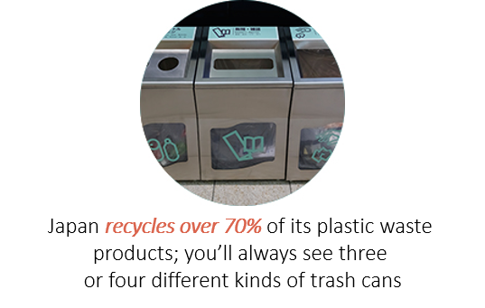
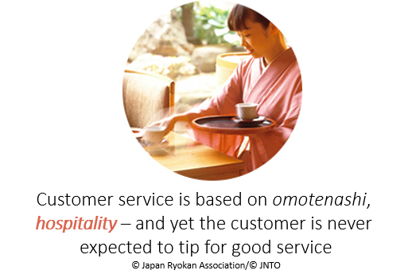
LIFESTYLE
Learning Japanese exposes you to fun
and thoughtful ways to live life

Slide 8
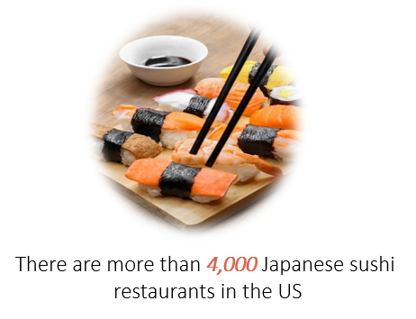
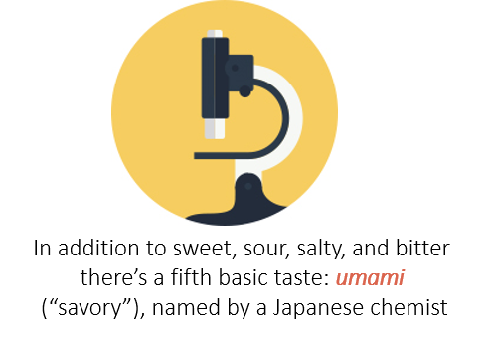
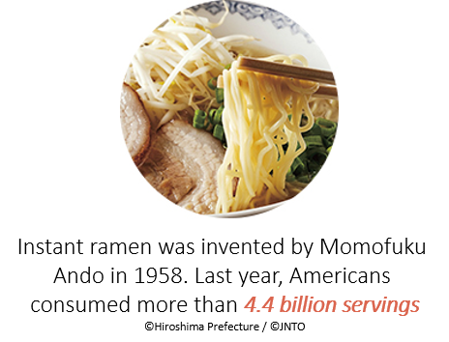
TASTE
Learning Japanese is delicious (oishii!)

Slide 9
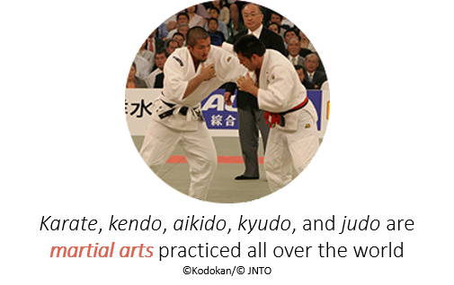
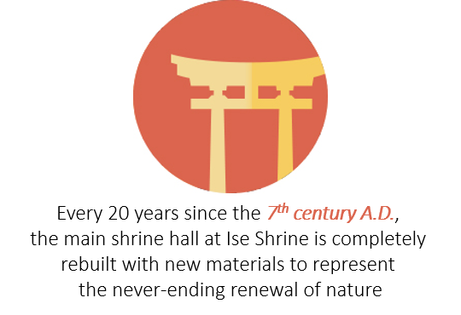
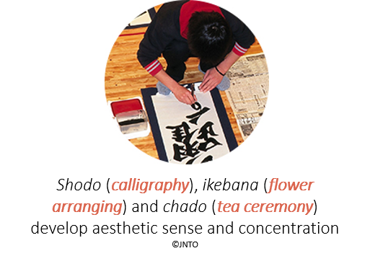
TRADITION
Learning Japanese exposes you to a
beautiful heritage which contemporary
people practice creatively

Slide 10
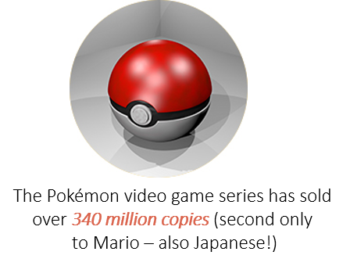
WONDER
Learning Japanese immerses you
in fantasy

